Slide 1
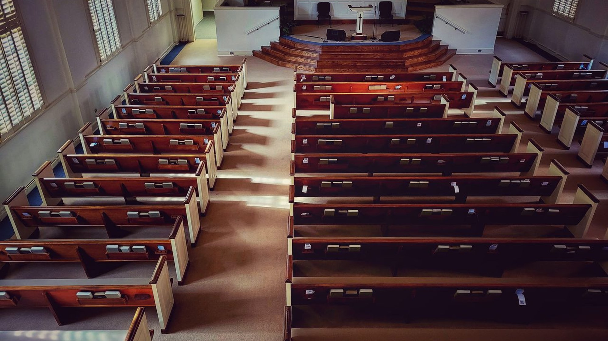
HOSPITALITY COMMITTEE
Fall Fellowship Reception
Planning brief, Saturday October 24, 2026, Fellowship Hall
Co-chairs June Randall and Loretta Simms

Slide 2
RUN OF SHOW
Setting Up the Day
Time | Activity | Lead
7:45 AM | Sound and chairs arrive | Curtis Mayhew
8:00 AM | Tables and setup | Loretta and Deacon Reese
9:00 AM | Kitchen staging begins | June Randall
10:30 AM | Beverages and welcome table | Renee Holloway
12:00 PM | Doors open, blessing | Pastor David
1:30 PM | Dessert table opens | Committee
2:45 PM | Cleanup begins | Otis Freeman
Fall Fellowship Reception | New Covenant Methodist Church
2

Slide 3

WELCOME
The Welcome Table Sets the Tone
Iced tea, lemonade, and coffee, ready before noon.
• Doors open at twelve, Pastor David gives the blessing.
• Flowers and programs on the welcome table.
• Renee Holloway greets as guests arrive.
Fall Fellowship Reception | New Covenant Methodist Church
3

Slide 4
THE MENU
Dish Assignments
Dish | Brought by | Servings
Baked ham, center dish | Committee | 40
Mac and cheese | June Randall | 40
Collard greens | Gloria Pruitt | 30
Cornbread | Sandra Whitfield | 40
Sweet potato pie | Yvette Carrington | 24
Iced tea and lemonade | Theodore Banks | 40
Fall Fellowship Reception | New Covenant Methodist Church
4

Slide 5
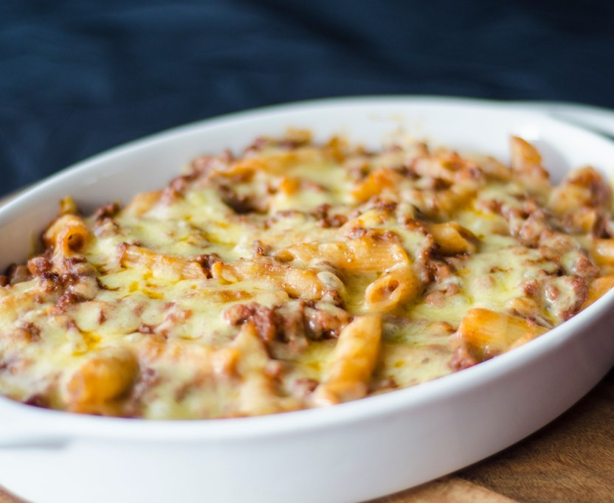
COMFORT FOOD
Made for a Crowd
Shared, home cooked dishes the congregation knows by heart.
• The reception centers on the dishes people ask for.
• Two warming trays stay running for the ham and the greens.
• Receipts go to June for the committee reimbursement form.
Fall Fellowship Reception | New Covenant Methodist Church
5

Slide 6
BUDGET AT A GLANCE
Tracking Under $220
Line item | Amount
Paper goods and serveware | $48.00
Decorations and table linens | $35.00
Beverages | $40.00
Ham, centerpiece dish | $52.00
Flowers for welcome table | $25.00
Total spend | $200.00
Remaining of $220 budget | $20.00
Approved committee budget is $220. Printed programs covered by the church office.
Fall Fellowship Reception | New Covenant Methodist Church
6

Slide 7
STANDING REMINDERS
Before the Doors Open
• Keep two warming trays running for the ham and the greens.
• Receipts to June for the committee reimbursement form.
• Confirm the greeter slot Friday evening.
• Hall cleared and returned to the trustees by 3:00 PM.
Fall Fellowship Reception | New Covenant Methodist Church
7

